Slide 1
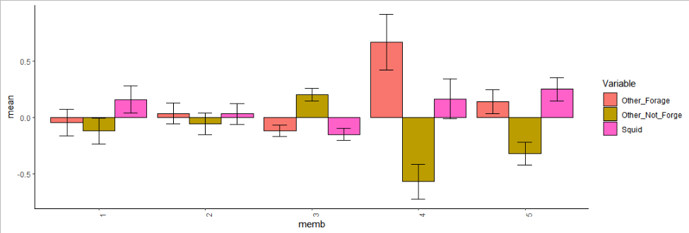
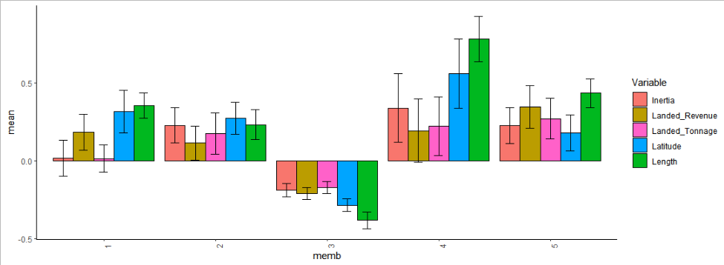
Clustering of 637 Vessels (any vessel who made a landing between 2000-2020 in which Forage Fish, excluding herring, comprised the majority of revenue)
n=77
n=112
n=317
n=33
n=98
Geography
Latitude, Inertia
Volume
Total Landed Tons,
Total Landed $
Length,
Weight
Characteristics
Catch Composition*
%Squid, %Other FF,
% Other Species
Average vessel
dissimilarity
*Broken down by Q1, Q2, Q3, &Q4

